Slide 1
Microsoft Sentinel
Brian Stockbrugger
Security Architect

Slide 2


Microsoft Sentinel Core Capabilities
Collect
Monitor and Detect
Investigate
Respond
Data
Visibility
Intelligence
Analytics
Hunting
Incidents
Automation
Data Connectors
Workbooks
Watchlists
TI Enrichment
Analytic Rules:
Scheduled
NRT
Fusion
Anomalies
Hunting Queries
Notebooks
Incident Management
and
Investigations
Remediation Playbooks
And
Automation Rules

Slide 3



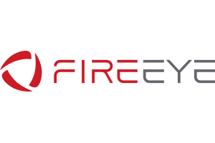
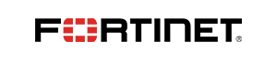


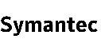








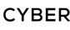










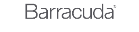
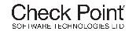







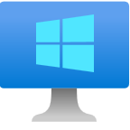



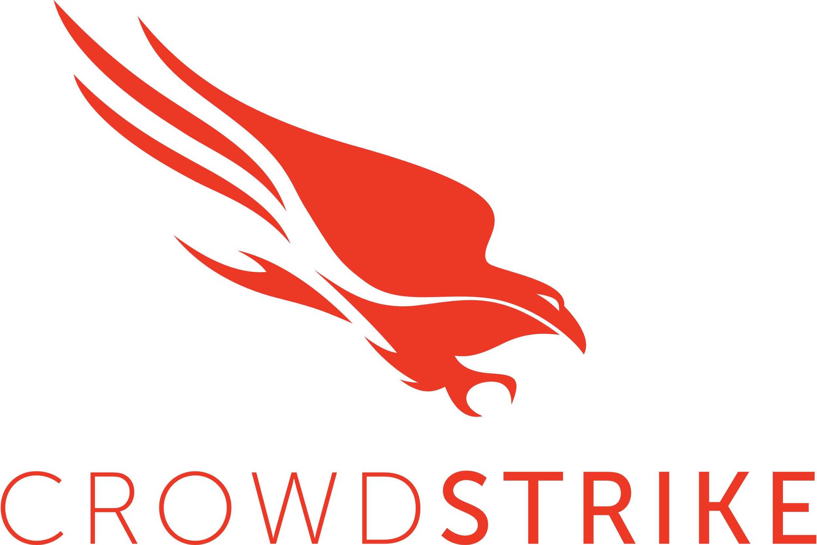


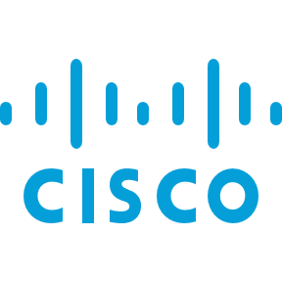


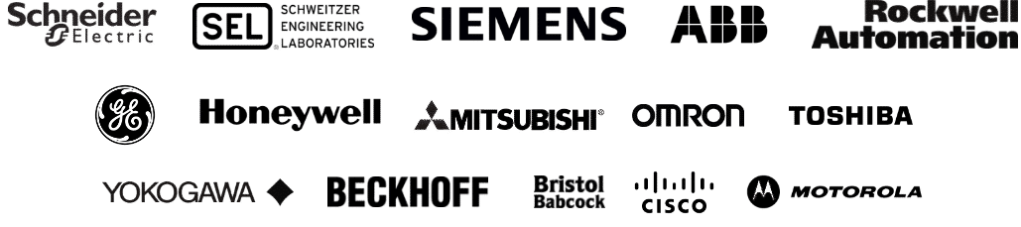
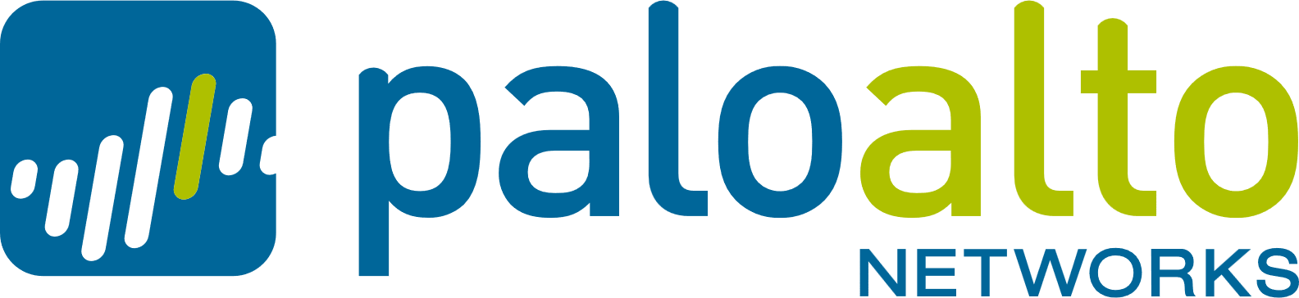
Data ingestion methods
Microsoft Partners / Threat Intelligence/
Azure
Vendors
S3
Built-in Data
Connectors
Native Data Connectors
Azure
Azure Active Directory
Azure Activity
Azure AD Identity Protection
Defender for Cloud
Microsoft Sentinel
Defender for Cloud Apps
Virtual Machines
Defender for Identity
Defender for Endpoints
Log Analytics
workspace
Defender for O365
Defender for IOT
Legend
Security Events
Win Event Forwarding
Syslog/CEF Data
TLS/SSL Encrypted Data
On-premises / IaaS
Security Events
Logstash
Defender for IoT
Online/Offline Sensor
Syslog, CEF, custom logs
TAP/SPAN
CEF logs
Syslog/CEF
Windows Server
With MMA agent
IOT/OT Network
Syslog
Linux (MMA Agent)
Windows
Servers
Syslog/CEF
Windows Server
With AMA
Linux (AMA Agent)
Syslog
WEF
Data Collection Rules (AMA Only)

Slide 4
Native Data Connectors
Data Ingestion Methods
Microsoft Partners / Threat Intelligence/
Vendors
S3
Built-in Data
Connectors
Azure
Native Data Connectors
Azure Active Directory
Azure Activity
Azure AD Identity Protection
Defender for Cloud
Microsoft Sentinel
Defender for Cloud Apps
Defender for Identity
Defender for Endpoints
Log Analytics
workspace
TLS/SSL
Defender for O365
Defender for IOT
Legend
Security Events
Win Event Forwarding
Syslog/CEF Data
TLS/SSL Encrypted Data
On-premises / IaaS
Security Events
Logstash
Defender for IoT
Online/Offline Sensor
Syslog, CEF, custom logs
TAP/SPAN
CEF logs
Syslog/CEF
Windows Server
With MMA agent
IOT/OT Network
Syslog
Linux (MMA Agent)
Windows
Servers
Syslog/CEF
Windows Server
With AMA
Linux (AMA Agent)
Syslog
WEF
Data Collection Rules (AMA Only)

Slide 5

Data ingestion methods
Microsoft Partners / Threat Intelligence/
Vendors
Azure
S3
Built-in Data
Connectors
Native Data Connectors
Azure Active Directory
Azure Diagnostic
Logs
Azure Activity
Azure AD Identity Protection
Defender for Cloud
Microsoft Sentinel
Defender for Cloud Apps
Defender for Identity
Defender for Endpoints
Log Analytics
workspace
TLS/SSL
Defender for O365
Defender for IOT
Legend
Security Events
Win Event Forwarding
Syslog/CEF Data
TLS/SSL Encrypted Data
On-premises / IaaS
Security Events
Logstash
Defender for IoT
Online/Offline Sensor
Syslog, CEF, custom logs
TAP/SPAN
CEF logs
Syslog/CEF
Windows Server
With MMA agent
IOT/OT Network
Syslog
Linux (MMA Agent)
Windows
Servers
Syslog/CEF
Windows Server
With AMA
Linux (AMA Agent)
Syslog
WEF
Data Collection Rules (AMA Only)

Slide 6
Data ingestion methods
Microsoft Partners / Threat Intelligence/
Vendors
Azure
S3
Built-in Data
Connectors
Native Data Connectors
Azure Active Directory
Azure Diagnostic
Logs
Azure Activity
Azure AD Identity Protection
Defender for Cloud
Virtual Machines
Microsoft Sentinel
Defender for Cloud Apps
Defender for Identity
Defender for Endpoints
TLS/SSL
Log Analytics
workspace
TLS/SSL
Defender for O365
Defender for IOT
Legend
Security Events
Win Event Forwarding
Syslog/CEF Data
TLS/SSL Encrypted Data
On-premises / IaaS
Security Events
Logstash
Defender for IoT
Online/Offline Sensor
Syslog, CEF, custom logs
TAP/SPAN
CEF logs
Syslog/CEF
Windows Server
With MMA agent
IOT/OT Network
Syslog
Linux (MMA Agent)
Windows
Servers
Syslog/CEF
Windows Server
With AMA
Linux (AMA Agent)
Syslog
WEF
Data Collection Rules (AMA Only)

Slide 7

Data ingestion methods
Microsoft Partners / Threat Intelligence/
Vendors
Azure
S3
Built-in Data
Connectors
Native Data Connectors
Rest API
Azure Active Directory
Azure Diagnostic
Logs
Azure Activity
Azure AD Identity Protection
Defender for Cloud
Virtual Machines
Microsoft Sentinel
Defender for Cloud Apps
Defender for Identity
Defender for Endpoints
TLS/SSL
Log Analytics
workspace
TLS/SSL
Defender for O365
Defender for IOT
Legend
Security Events
Win Event Forwarding
Syslog/CEF Data
TLS/SSL Encrypted Data
On-premises / IaaS
Security Events
Logstash
Defender for IoT
Online/Offline Sensor
Syslog, CEF, custom logs
TAP/SPAN
CEF logs
Syslog/CEF
Windows Server
With MMA agent
IOT/OT Network
Syslog
Linux (MMA Agent)
Windows
Servers
Syslog/CEF
Windows Server
With AMA
Linux (AMA Agent)
Syslog
WEF
Data Collection Rules (AMA Only)

Slide 8
Data ingestion methods
Microsoft Partners / Threat Intelligence/
Vendors
Azure
S3
Built-in Data
Connectors
Native Data Connectors
Rest API
Azure Active Directory
Azure Diagnostic
Logs
Azure Activity
Azure AD Identity Protection
Defender for Cloud
Virtual Machines
Microsoft Sentinel
Defender for Cloud Apps
Defender for Identity
Defender for Endpoints
TLS/SSL
Log Analytics
workspace
TLS/SSL
Defender for O365
Defender for IOT
On-premises / IaaS
Logstash
Defender for IoT
Online/Offline Sensor
Syslog, CEF, custom logs
TAP/SPAN
Legend
CEF logs
Syslog/CEF forwarding
Windows Server
With MMA agent
Security Events
IOT/OT Network
Win Event Forwarding
Syslog
Linux (MMA Agent)
Windows
Servers
Syslog/CEF Data
Syslog/CEF forwarding
Windows Server
With AMA
TLS/SSL Encrypted Data
Linux Syslog (AMA Agent)
WEF
Data Collection Rules (AMA Only)

Slide 9





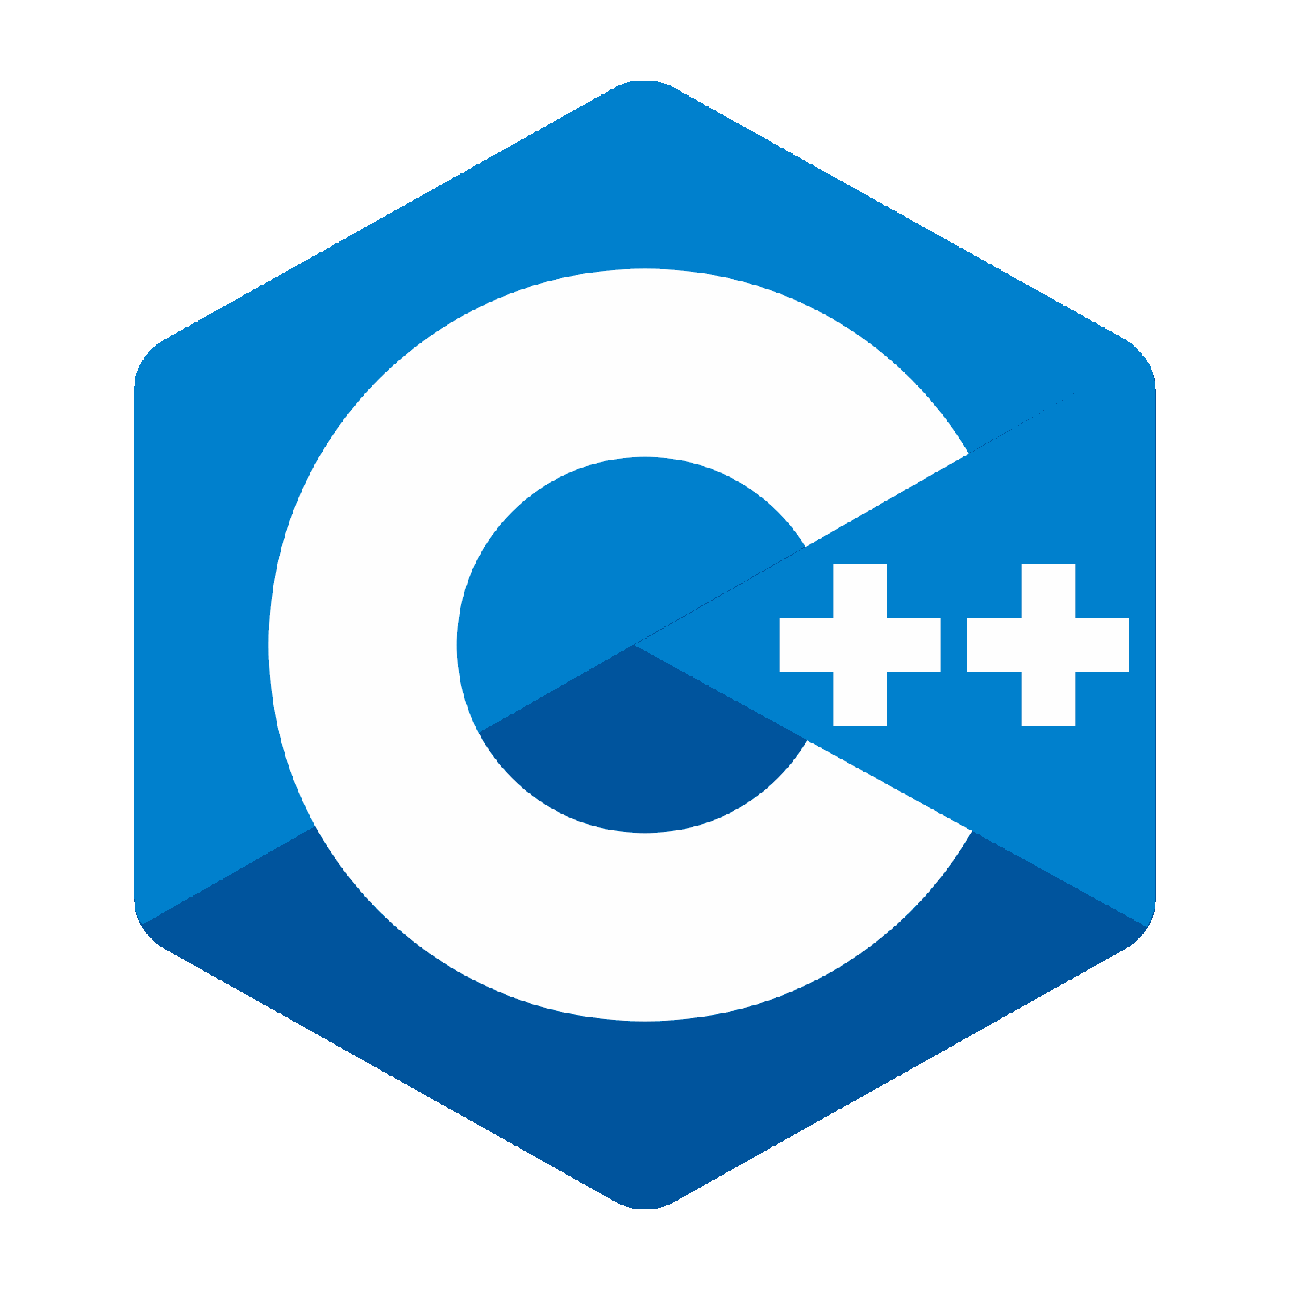



Data ingestion methods
Custom Application
Microsoft Partners / Threat Intelligence/
Vendors
Azure
S3
Built-in Data
Connectors
Native Data Connectors
Rest API
Azure Active Directory
Azure Diagnostic
Logs
Azure Activity
Azure AD Identity Protection
Defender for Cloud
Virtual Machines
Microsoft Sentinel
Defender for Cloud Apps
Defender for Identity
Defender for Endpoints
TLS/SSL
Log Analytics
workspace
TLS/SSL
Defender for O365
Defender for IOT
On-premises / IaaS
Security Events
Logstash
Defender for IoT
Online/Offline Sensor
Syslog, CEF, custom logs
TAP/SPAN
Legend
CEF logs
Syslog/CEF forwarding
Windows Server
With MMA agent
Security Events
IOT/OT Network
Win Event Forwarding
Syslog
Linux (MMA Agent)
Windows
Servers
Syslog/CEF Data
Syslog/CEF forwarding
Windows Server
With AMA
TLS/SSL Encrypted Data
Linux syslog (AMA Agent)
WEF
Data Collection Rules (AMA Only)

Slide 10
Data ingestion methods
Custom Application
Microsoft Partners / Threat Intelligence/
Vendors
Azure
S3
Built-in Data
Connectors
Native Data Connectors
Rest API
Azure Active Directory
Azure Diagnostic
Logs
Azure Activity
Azure AD Identity Protection
Defender for Cloud
Virtual Machines
Microsoft Sentinel
Defender for Cloud Apps
Defender for Identity
Defender for Endpoints
TLS/SSL
Log Analytics
workspace
TLS/SSL
Defender for O365
Defender for IOT
On-premises / IaaS
Security Events
Logstash
Defender for IoT
Online/Offline Sensor
Syslog, CEF, custom logs
TAP/SPAN
Legend
CEF logs
Syslog/CEF forwarding
Windows Server
With MMA agent
Security Events
IOT/OT Network
Win Event Forwarding
Syslog
Linux (MMA Agent)
Windows
Servers
Syslog/CEF forwarding
Syslog/CEF Data
Windows Server
With AMA
TLS/SSL Encrypted Data
Linux syslog (AMA Agent)
WEF
Data Collection Rules (AMA Only)

Slide 11
Microsoft Sentinel for MSSP
Partner
Customer
Reference Architecture
MSSP Operations
Azure Subscription 1
Customer 1
Azure Subscription 2
CI/CD Pipeline
Partner Admin Center
PAL Registration
Workbooks
Logic Apps
SOC Collaboration
M365 Subscription
Azure Lighthouse
Microsoft Sentinel
Protected IP
Log Analytics
Teams for secure collaboration and communication
Optional
Microsoft Sentinel API
Logic Apps
B2B
Customer Identity
Azure AD: Tenant 3
Microsoft Sentinel
Cross Workspace Incident View
Customer 2
CA
Log Analytics
Customer 3
Customer 4
PIM
MSSP Identity
Azure AD: Tenant 2

Slide 12
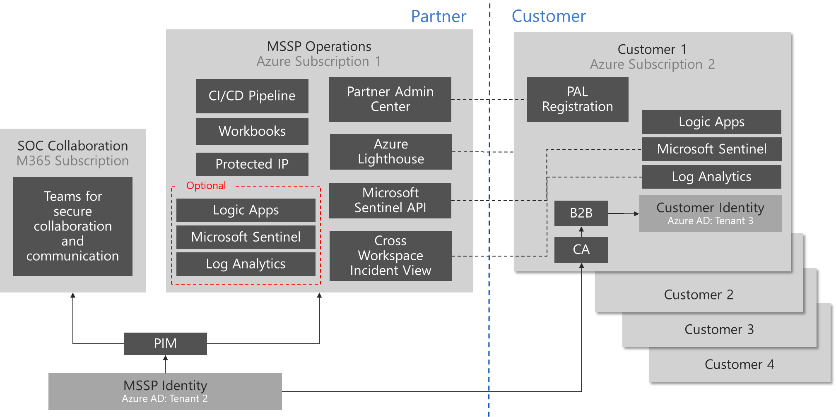
Microsoft Sentinel for MSSP
Reference Architecture
Syslog
Customer Data
On-premises
Customer Data
Azure Subscriptions
Customer Data
Office 365
Customer Data
Other Cloud Services

Slide 13
Manage costs as you ingest more data
Current features
New features
Analytics Logs
Full KQL, Alerts supported, No query limits, 90 days included
Basic Logs
Reduced KQL, Alerts not supported, Query concurrency limits, 8 days retention included
Ingestion charge
Log Analytics: $1.6 to $2.3/GB
Microsoft Sentinel: $0.7 to $2.0/GB
Query charge
N/A
Ingestion charge
Log Analytics: $0.50/GB;
Microsoft Sentinel: $0.50/GB
Commitment Tiers not available
Search query charge
Log Analytics: $0.005/GB-scanned;
Data retention
Full KQL, 90 days included, 2-year max. retention
$0.10/GB-month
Search job charge*:
$0.005/GB -scanned
Restore charge
$0.10/GB/day*
Min. daily charge for 2TB and 12-hours (~$96)
*pro-rated hourly
Data archive
Batch queries with limited KQL, 0 to 7-year max. archive
Data Archive Charge: $0.02/GB/month

Slide 14
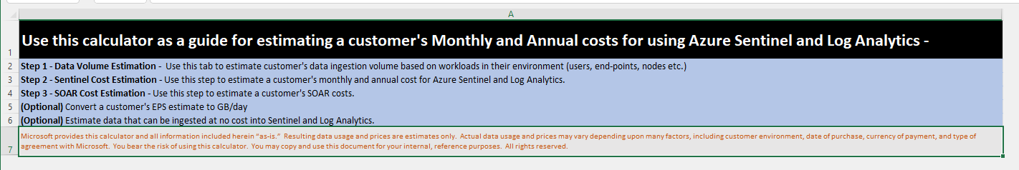
Calculators
https://cloudpartners.transform.microsoft.com/download?assetname=assets/Azure_Sentinel_Calculator.xlsx&download=1
https://dataexplorer.azure.com/AzureDataExplorerCostEstimator.html

Slide 15


1. Microsoft Sentinel free trial
Ingest up to 10GB/day for first 31 days
OR
Add Microsoft Sentinel to your existing Log Analytics for free for first 31 days
Microsoft Sentinel
Azure Monitor Log Analytics
Usage beyond these limits will be charged per pricing listed on this page.
Charges related to additional capabilities for automation and bring your own machine learning are still applicable during the free trial.

Slide 16

2. Microsoft Sentinel benefit for Microsoft 365 E5, A5,F5 and G5* customers
Save up to US2200/month on a typical 3,500 seat deployment of Microsoft 365 E5 with up to 5MB per user/day of free data ingestion into Microsoft Sentinel
Applied automatically at the end of the month – no enrollment or nomination process.
Eligibility: Microsoft 365 E5, A5,F5 and G5* or Microsoft 365 E5, A5,F5 and G5* security customers
Data sources included in the offer:
Azure Active Directory (Azure AD) sign-in and audit logs
Microsoft Cloud App Security shadow IT discovery logs
Microsoft Information Protection logs
Microsoft 365 advanced hunting data
https://aka.ms/m365-sentinel-offer
Internal FAQ on GearUp
*Microsoft waives any and all entitlement to compensation for the services provided to you under this agreement. Microsoft intends that these services and associated terms be in compliance with applicable laws and regulations with respect to gratuitous services. It is specifically understood that all services and services deliverables provided are for the sole benefit and use of the government entity and are not provided for personal use or benefit of any individual government employee.

Slide 17
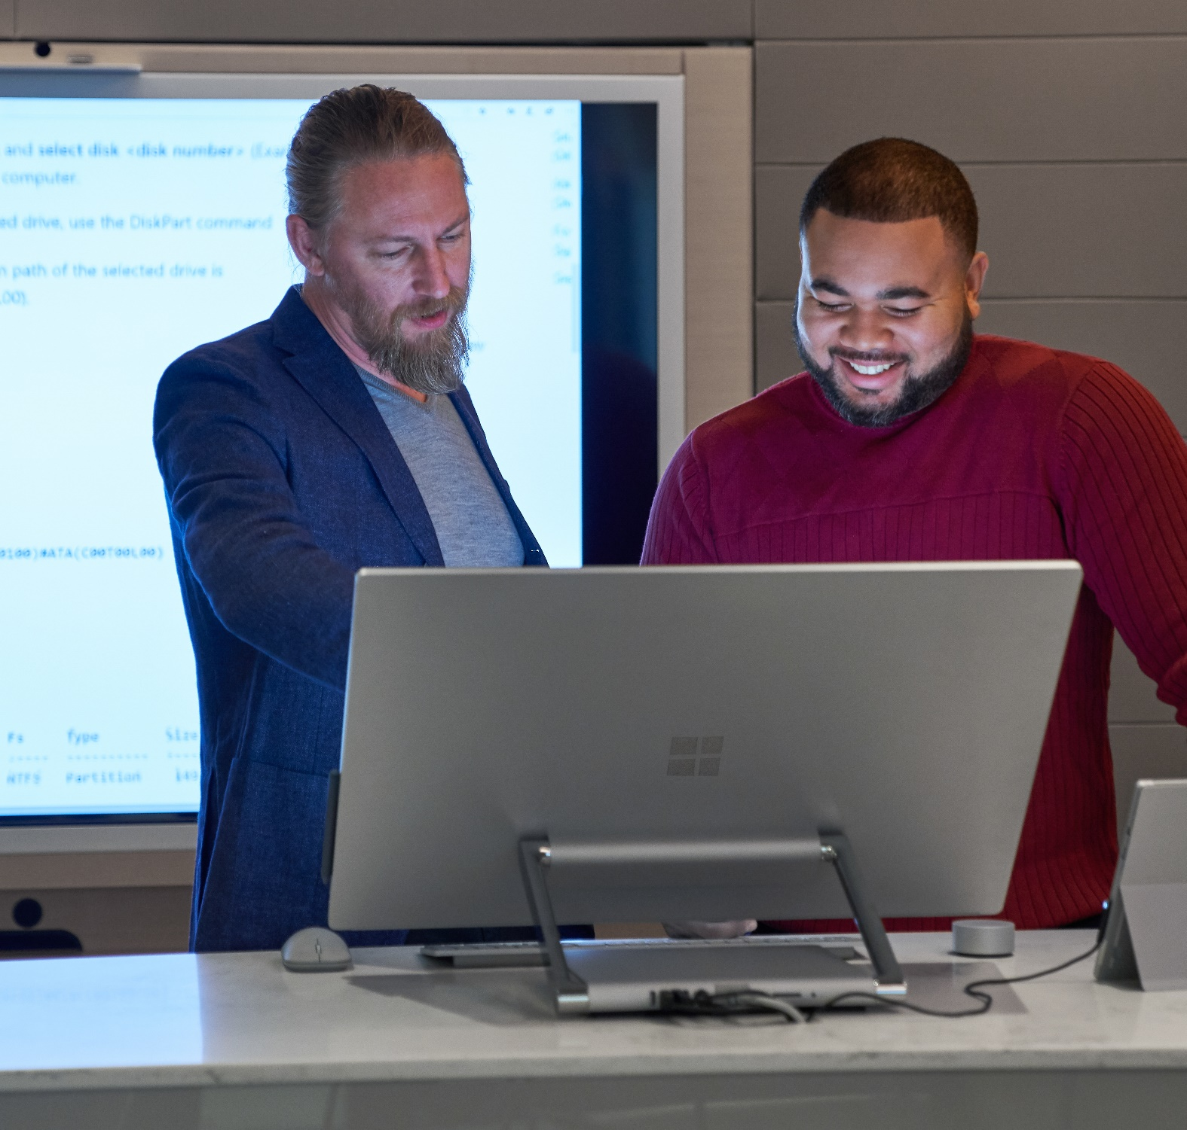
3. Always Free Data Sources
Azure Activity Logs
Office 365 Audit Logs, including all SharePoint activity, Exchange admin activity, and Teams.
Alerts from Microsoft Defender for Cloud, Microsoft 365 Defender, Microsoft Defender for Office 365, Microsoft Defender for Identity, Microsoft Defender for Endpoint and Microsoft Defender for Cloud Apps

